Slide 1

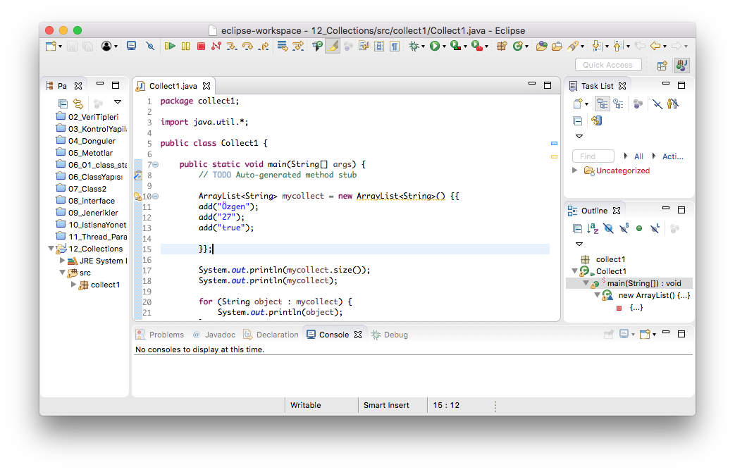
Annotation
Target
TYPE
ANNOTATION_TYPE
FIELD
METHOD
PACKAGE
CONSTRUCTOR
PARAMETER

Slide 2
Target
TYPE
FIELD
METHOD
PACKAGE
CONSTRUCTOR
PARAMETER
CLASS, INTERFACE, ENUM
VARIABLE
METHOD, FUNCTION
PACKAGE
CONSTRUCTOR
PARAMETER

